Slide 1



Paper ID: SPEC 2063
Retrieve, processing and analysis of global positioning system derived
Ionospheric total electron content using IGS products
Presented by:
J R K Kumar. Dabbakuti,
Authors:
Kowshik Chandu, Y Sai Koushik Reddy and A V Prabu
Dept., of ECM, KL Deemed to be University,
Andhra Pradesh, India.
Second International Conference on Advances in Electrical and Computer Technologies, June 2020 (ICAECT 2020)

Slide 2
Introduction GNSS
Global Navigation Satellite System (GNSS) comprise several constellations such as
GPS (United States)
GLONASS (Russia)
GALILEO (Europe)
COMPASS (China)
IRNSS (India)
GNSS is designed to provide the instantaneous positioning, timing and navigation (PTN) information any where in the world .

Slide 3
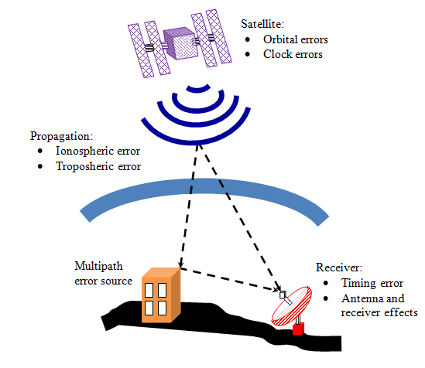
Sources of GNSS error
Table 1: GPS Error Budget
Error Source | Error (meters)
Satellite Clocks | 1.5
Orbit Errors | 2.5
Ionosphere | 5.0
Troposphere | 0.5
Receiver Noise | 0.3
Multipath | 0.6
Among all the errors, ionospheric error is found to be the most dominant
Sources of error in GPS signal

Slide 4
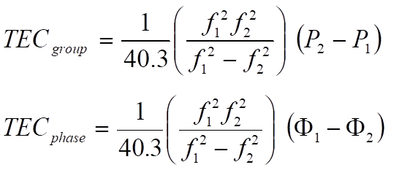
(Total Electron Content)
TEC is an important descriptive quantity for the ionosphere
key parameter for the correction of ionospheric effects which degrade GNSS positioning accuracy [1, 2] and the monitoring of space weather events.
Each satellite broadcasts two L-band signals at 1575.42 MHz (f1) and 1227.60 MHz (f2) frequencies.
Time delay measurements of L1 and L2 frequencies can therefore be converted to TEC along the ray path from the receiver to the satellite.

Slide 5
Paper ID: SPEC 2063
Hence, TEC is an important parameter to detect ionospheric disturbances which could affect aircraft and spacecraft crew and equipment, wired and wireless communication, electric power distribution grids, surveying and navigation, all with a social and economical severe impact [3, 4].
How to Retrieve, processing and analysis GPS derived Ionospheric TEC?

Slide 6
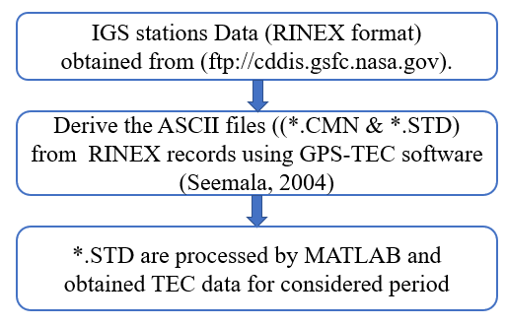
Paper ID: SPEC 2063
Fig. 1. Flowchart for Retrieve, processing and analysis of GPS-TEC

Slide 7
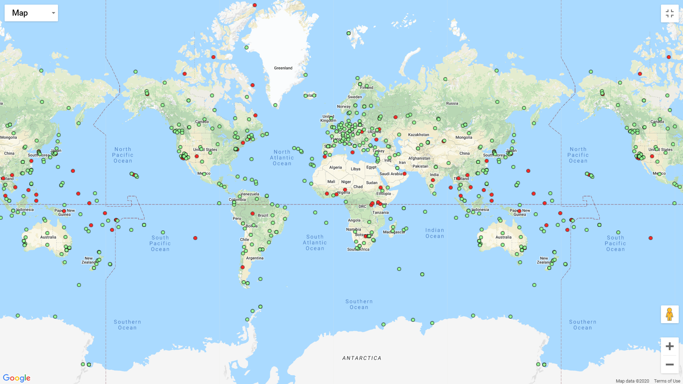
Paper ID: SPEC 2063
Thanks to International GNSS service (IGS) Global Navigation Satellite Systems (GNSS) tracking infrastructure implemented by the International Association of Geodesy (IAG) for provide TEC measurements worldwide coverage (Fig.1 ).
RINEX data can be obtained from (ftp://cddis.gsfc.nasa.gov/pub/gps/data/daily).
#!bash for i in {001..365} do for j in IGS station ID do wget -c ftp://cddis.gsfc.nasa.gov/pub/gps/data/daily/Year/"i"/Yo/j"i"0.Yo.Z done done
Retrieve program code for IGS RINEX data
Fig.2 IGS Network coverage.
http://www.igs.org/network

Slide 8
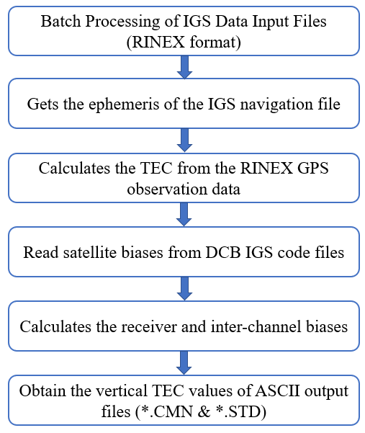
Paper ID: SPEC 2063
GPS-RINEX observations were processed using GPS-TEC analysis software developed by Gopi Seemala at Boston College [5] .
Fig. 3. The flowchart illustrating the processing of IGS RINEX data into ASCII output format

Slide 9
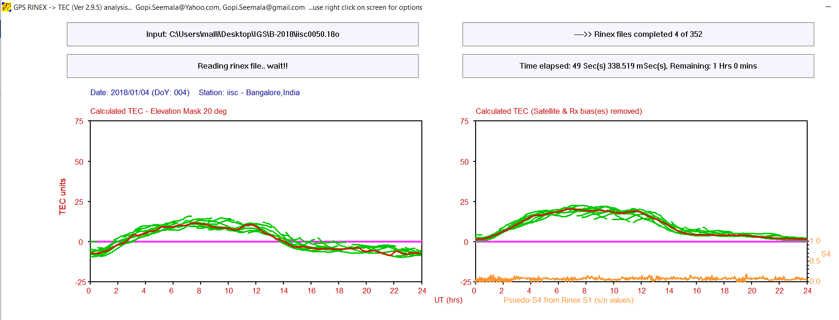
Paper ID: SPEC 2063
Fig. 4. GPS-TEC variations from GPS–TEC analysis software [5]

Slide 10
Paper ID: SPEC 2063
Analysis of GPS-TEC algorithm using MATLAB
clc; clear all;
FileList = dir('*.std/*.cnm ');
N = size(FileList,1);
for k = 1:N
filename1{k}= FileList(k).name;
disp(filename1);
end
for k=1:N
filename=fopen(filename1{k});
mydata{k}=textscan(filename,'%s’);
end
for i=1:length(mydata)
for j=1:4
mydata1{i}(:,j)=mydata{i}{j};
end
end
AA=[]
mydata2=[]
for i=1:length(mydata1)
mydata2=[mydata2; mydata1{i}];
if length(mydata2)==1440
mydata2=mydata2;
else
B=zeros(1440-length(mydata1{i}),4);
A=vertcat(mydata1{i});
mydata2=[A;num2cell(B)];
end
AA=[AA mydata2'];
end
save ('IGSDATA,'AA')

Slide 11
Paper ID: SPEC 2063
Fig. 5. GPS-vTEC variation at Hyderabad GNSS Station for the year 2018

Slide 12
Paper ID: SPEC 2063
Conclusions
In this paper, we presented methods for retrieval, processing and analysis of GPS-TEC data using different techniques.
Three scenarios are used to obtain GPS-TEC data from the IGS network. First, raw observation in RINEX format retrieves data from the anonymous FTP site CDDIS using the Unix shell written in Bash language and can be executed by command-line interface approach.
Secondly, the strategy of processing RINEX observation files by Gopi Seemala TEC software implemented at Boston College.
Third, ASCII files from the GPS-TEC software are processed with the Matlab script to obtain the observed GPS-TEC data.

Slide 13
Paper ID: SPEC 2063
Applications
Since the establishment of the IGS tracking infrastructure, GNSS became a well established tool for ionospheric sounding as these systems offer an unprecedented combination of accuracy, temporal and spatial resolution and availability.
This led to important progress in fields such as ionospheric modelling [6], forecasting [7], IoT based monitoring and forecasting applications [8-9].
With the regionally enormous increase in highly precise GNSS data, the demands on (near) real-time ionosphere products, necessary in many applications such as navigation, are growing very fast.

Slide 14
Paper ID: SPEC 2063
References
Gao ZG, Zhang LQ (2006) Multi-seasonal spectral characteristics analysis of coastal salt marsh vegetation in Shanghai, China. Estuar Coast Shelf Sci 69(1–2):217–224
Le A, Tiberius C, van der Marel H, Jakowski N (2009) Use of global and regional ionosphere maps for single-frequency precise point positioning. In: Sideris MG (ed) Observing our changing earth. International Association of Geodesy Symposia, vol 133. Springer, Berlin, Heidelberg, pp 759–769
Meehan J, Fisher G, Murtagh W (2010) Understanding space weather customers in GPS-reliant industries. Space Weather 8(6):1–3 7.
Board, Space Studies and National Research Council and others (2009) Severe space weather events: understanding societal and economic impacts: a workshop report. National Academies Press
Gopi, S.: Rinex GPS-TEC program, version 1.45. Boston College (2010)

Slide 15
Paper ID: SPEC 2063
References
6. Ratnam, D.V., Dabbakuti, J.K., Lakshmi, N.S.: Improvement of Indian-Regional Klobuchar Ionospheric Model Parameters for Single-Frequency GNSS Users. IEEE Geoscience and Remote Sensing Letters 15, 971-975 (2018)
7. Dabbakuti, J.R.K.K., Jacob, A., Veeravalli, V.R., Kallakunta, R.K.: Implementation of IoT analytics ionospheric forecasting system based on machine learning and ThingSpeak. IET Radar, Sonar & Navigation 14, 341-347 (2019)
8. Dabbakuti, J.K., Ch, B.: ‘Ionospheric monitoring system based on the internet of things with thingspeak’, Astrophys. Space Sci., 364, (8), p. 137, (2019)
9.Dabbakuti, J.R.K.K., G, B.L.: Application of Singular Spectrum Analysis Using Artificial Neural Networks in TEC Predictions for Ionospheric Space Weather. IEEE Journal of Selected Topics in Applied Earth Observations and Remote Sensing 12, 5101-5107 (2019)

Slide 16
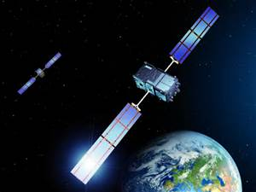
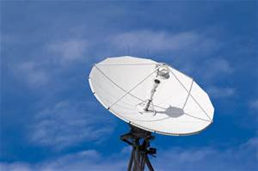
Thank you for your attention
……J R K Kumar Dabbakuti

